Slide 1

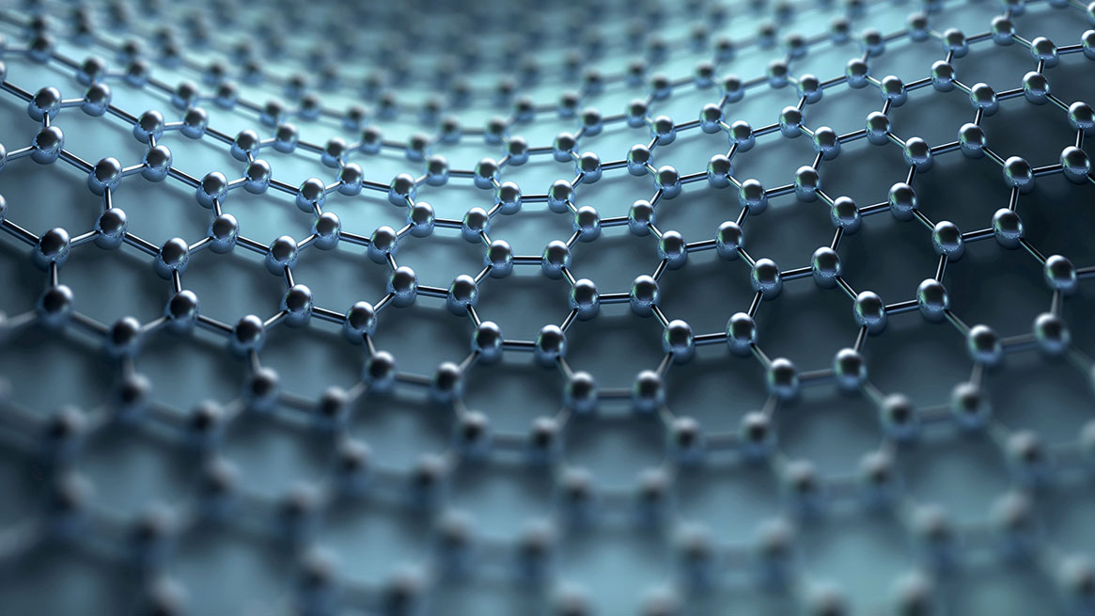
AUTOMATED ALGORITHMIC ACCIDENT PREVENTION SYSTEM
GUIDE : SUBMITTED BY:
Dr. S. BALAJI.,(Ph.D.), GUNASEELAN k (211417104072)
Head of assistant professor HARIHARAN B (211417104075)
department of cse SUDHARSAN K (211417104272)
panimalar engineering college

Slide 2
INTRODUCTION
Now-a-days most of the accidents are occurring during the Mist Season. During this season the Vehicle Drivers cannot able to have the clear vision of the before vehicles or road. Thus in majority of the time it may results in an Accidents.
There is no chance to stop the Vehicle by the Drivers during such situation because they may travel at high speed and they will see the Vehicle when reaches the before Vehicle most closely.
Our Proposed Model will intimate them when they drive the vehicle very closely to the another vehicle by displaying an information about the Distance between the Vehicles with the help of VFDT Algorithm (which alerts the user according to the driven speed) via LCD Display or LCD Monitor which will be placed infront of Driver Seat and also the LCD Display will be placed at the backside of the Vehicle which will be useful for the rear Vehicle driver to detect the speed of the front vehicle and make to manage their vehicle speed. It is used during all the time.
This Model also useful when an accident occurs by passing an information to the corresponding user. When an accident occurs, the Crash Sensor in the vehicle will send an information and also intimates the GPS Module to gather current Location of the vehicle and sends it to the particular user via GSM Module.

Slide 3
LITERATURE SURVEY
Heading | DESCRIPTION
“A RESEARCH REVIEW ON AIRBAG IN AUTOMOBILE SAFETY SYSTEM” | This paper explains about how the airbag in the vehicle has initiated when an accident occurred.
“IMPLEMENTATION OF VEHICLE MONITORING AND TRACKING SYSTEM” | This journal explains about the usage of the IoT components in the vehicles which is useful for the drivers to predict the air pressure in tires, rearside cameras etc.
“VFDT Algorithm by Sharmishta Desai and Sourav Roy, and Brina Patel” | This Journal introduces the concept of VFDT Algorithm which is useful for the fast retrieval of information. It also describes that the VFDT is the best tree algorithm, rather than the Iterative-Dichotomiser 3 and C4.

Slide 4
PROBLEM STATEMENT
The main impact of this project is to minimize the number of accidents occurring now-a-days. Thus we come up with solution for the following problems.
First, Now-a-days, more number of accidents occurs during the time of Mist season due to invisibility of ahead vehicles by the drivers and we can resolve this by intimating the distance between the current and ahead vehicles to the driver using VFDT Algorithm.
The next main reason for the accidents is, in normal times during traffic or overtaking the vehicle, the driver cannot able to predict the amount of brake applied by the before vehicle so the vehicle went to an accident with the before vehicle and thus the upcoming vehicles also get damaged. Thus we can resolve it by placing the LCD display at the Vehicle.
Suppose if accidents occurred beyond the drivers control then our proposed system suddenly sends an info about the accident to the registered persons . Our proposed concept can be implement using IoT domain which performs all the above tasks.

Slide 5
TECHNOLOGY STACK
Software:
Arduino Software
Hardware:
Arduino UNO Board
Ultrasonic Sensor, Crash Sensor
Global Positioning System (GPS)
Global System for Mobile Communication (GSM Module)
Liquid Crystal Display (LCD)

Slide 6
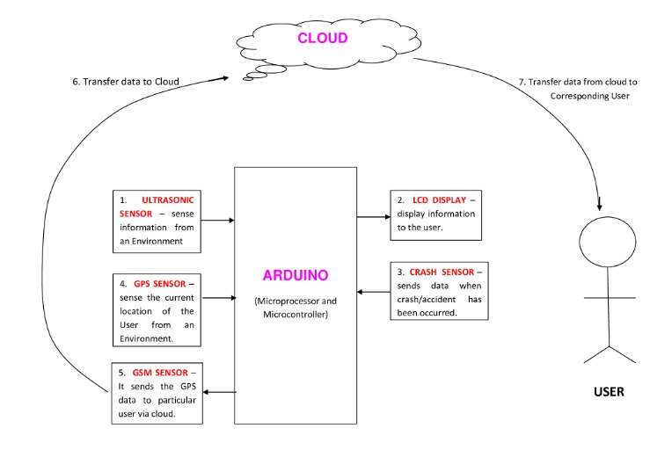
SYSTEM ARCHITECTURE

Slide 7
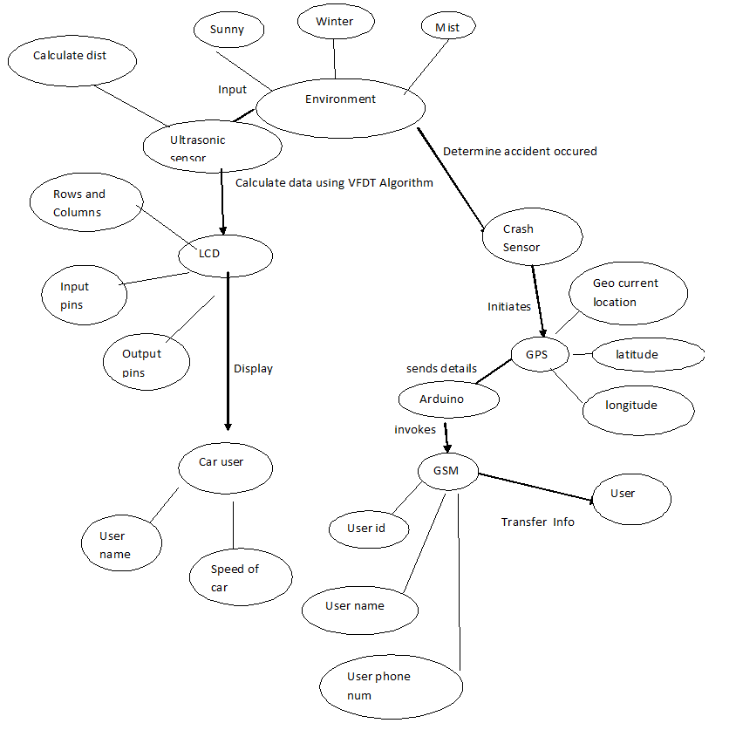
SYSTEM DESIGN
ER Diagram

Slide 8
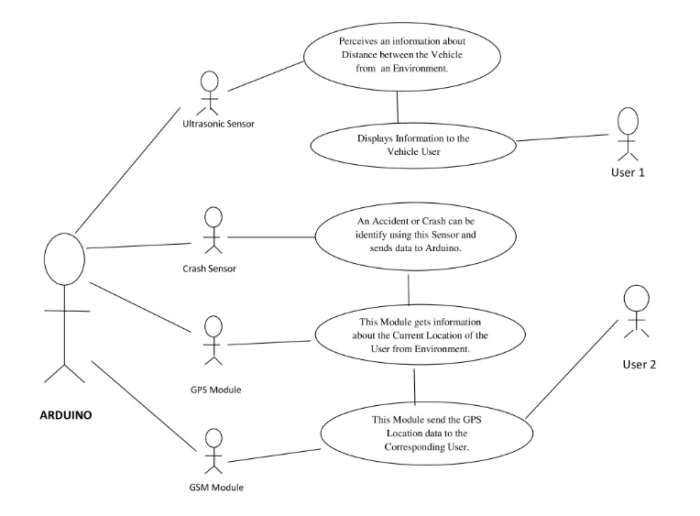
UseCase Diagram

Slide 9
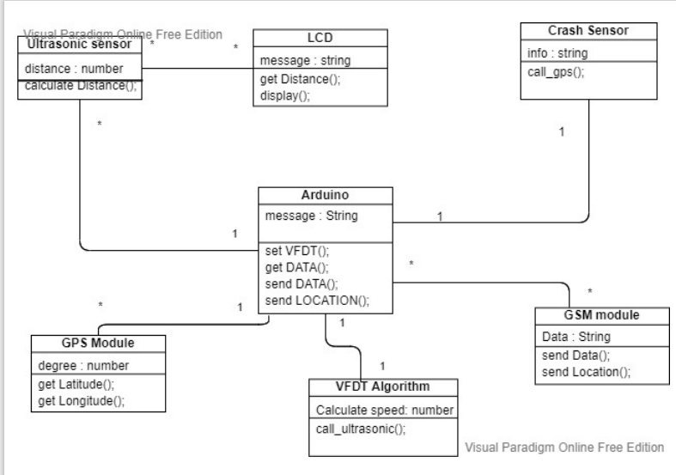
Class Diagram

Slide 10
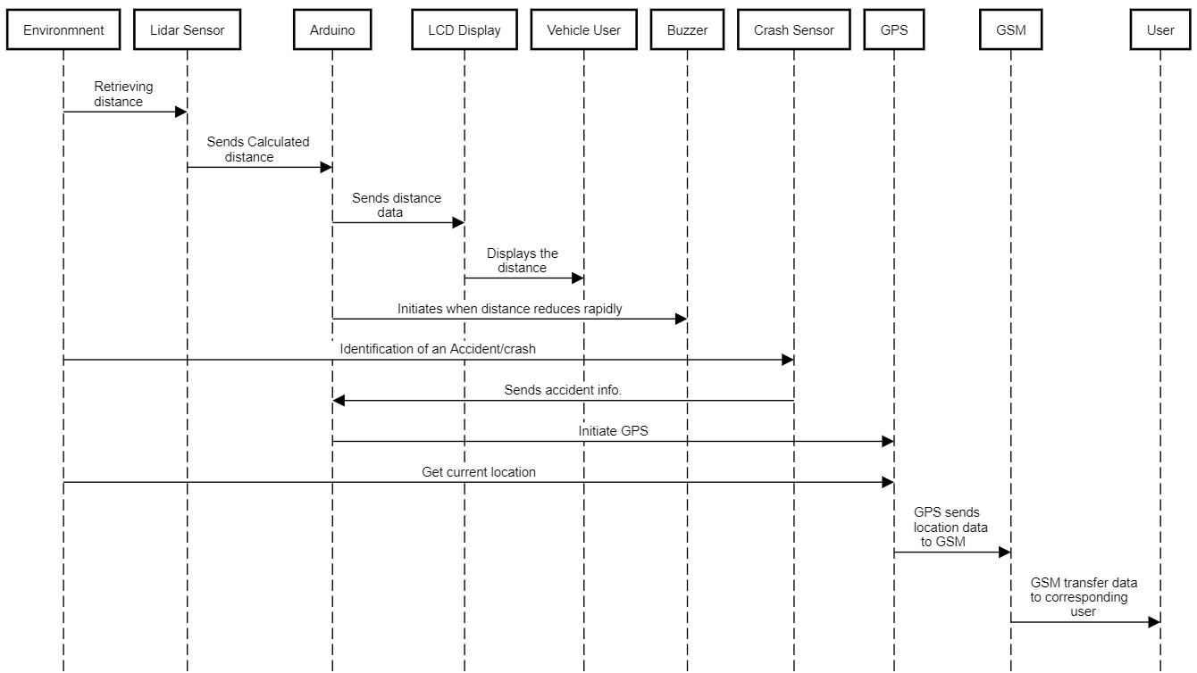
Sequence Diagram

Slide 11
MODULE DESCRIPTION
Arduino UNO Board :
The Arduino Uno is a microcontroller board based on the ATmega328. It has 20 digital input/output pins (of which 6 can be used as PWM outputs and 6 can be used as analog inputs), a 16 MHz resonator, a USB connection, a power jack, an in-circuit system programming (ICSP) header, and a reset button.
The Arduino Uno can be powered by USB cable or directly supplying 9-12v from the barrel jack. The circuitry operates at 5v dc which in case input more than that is regulated with the help of 7805 voltage regulator. The 7805 voltage regulator ic is used regulate the voltage supplied to the arduino board and manage it through processor and other elements.
Arduino Uno can detect the surroundings from the input. Here the input is a variety of sensors and these can affect its surroundings through controlling motors, lights, other actuators, etc. The ATmega328 microcontroller on the Arduino board can be programmed with the help of an Arduino programming language and the IDE (Integrated Development Environment). Arduino projects can communicate by software while running on a PC.

Slide 12
Ultrasonic Sensor :
Ultrasonic sensors measure distance by passing ultrasonic waves. The sensor head emits an ultrasonic wave and receives the wave which has been reflected back from the target. It measures the distance to the target by measuring the time between the emission and reception.
The distance can be calculated with the following formula: Distance L = 1/2 × T × C
Crash sensors collect the data necessary to make decision when an accident occurs. Crash sensors measure how quickly a vehicle crash with before vehicle and also accelerates to the side in a side-impact crash. Some vehicles consist of a sensing system which has been designed to detect the onset of a rollover crashes. Frontal crash sensors may be located at the front of the vehicle near the engine, and also at the sides of vehicle, or sometimes in the electronic control unit (ECU).

Slide 13
GPS Module
The Global Positioning System (GPS) is a gadget that can receive information from GNSS satellites and then compute its geographic position. It is one of the Global Navigation Satellite Systems (GNSS), which gives geolocation and time information to a GPS receiver anywhere on or near the Earth when four or more GPS satellites can be seen without obstruction. The GPS does not require the user to send any data, and it works independently of telephonic or internet reception, however both technologies can improve the accuracy of GPS positioning data.
GSM Module
A GSM or GPRS module is a circuited chip that allows a mobile device or a connected modules to communicate with a GSM or GPRS system. This module can be used to send a message to a registered phone number (which should be configure in GSM Module)

Slide 14
LCD Display
The LCD Display (Liquid Crystal Display) on the Arduino is a form of display that runs on liquid crystals. We'll take serial input from the computer and upload the sketch to the Arduino from here. On the LCD, the characters will be shown. LCD technology allowed for significantly thinner displays than cathode ray tube (CRT) technology. LCDs use a lot less energy than LEDs. A backlight illuminates the liquid crystals in an LCD, resulting in a picture. Overall, displaying the data evaluated by the Sensor is beneficial.

Slide 15
VFDT Algorithm
Proposes to implement and use the very fast decision tree (VFDT) algorithm can effectively perform a test-and-train process with a limited segment of data. In contrast with traditional algorithms, the VFDT does not require that the full dataset be read as part of the learning process thus reducing time. As a preemptive approach to minimizing the impacts of imperfect data streams, a data cache and missing-data-guessing mechanism called the auxiliary reconciliation control is proposed to function as a within VFDT. We have also conducted an extensive analysis on various datasets which have proved our proposed algorithm to be more efficient in terms of time compared to the other existing decision tree models. This implementation can form a base for a large number of applications for handling Big Data. We have replaced the serial execution of VFDT algorithm by a series of Map and Reduce functions.

Slide 16
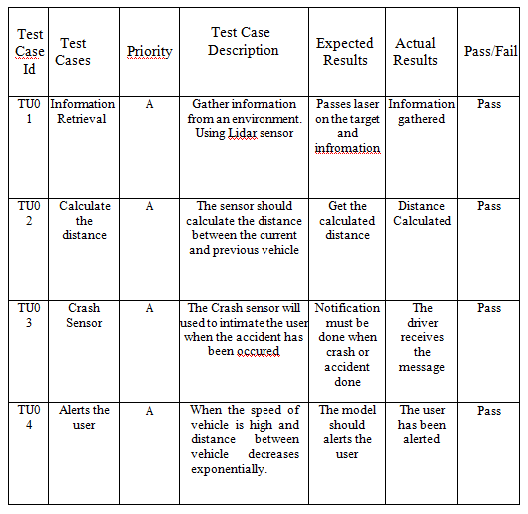
PERFORMANCE EVALUATION
TestCases For Sensors

Slide 17
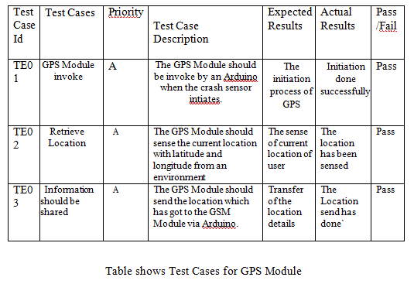
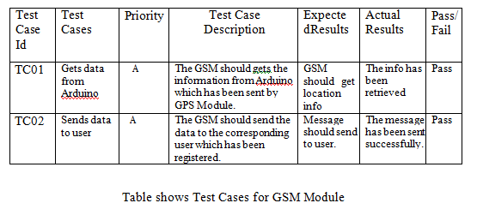
TestCases For GPS and GSM Module

Slide 18
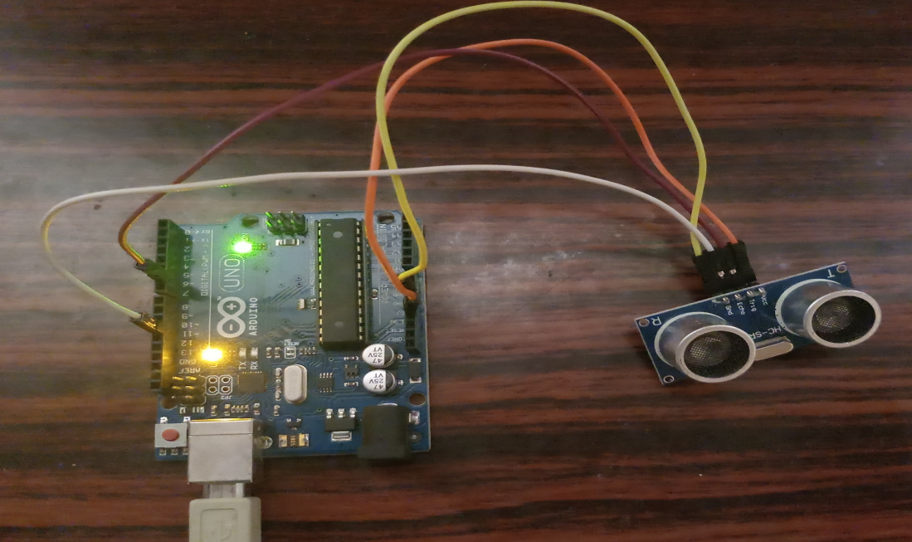
SCREENSHOTS
UltraSonic Sensor

Slide 19
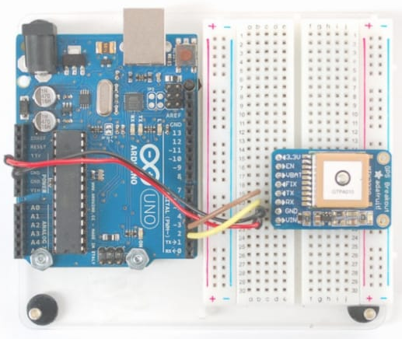
GPS Module

Slide 20
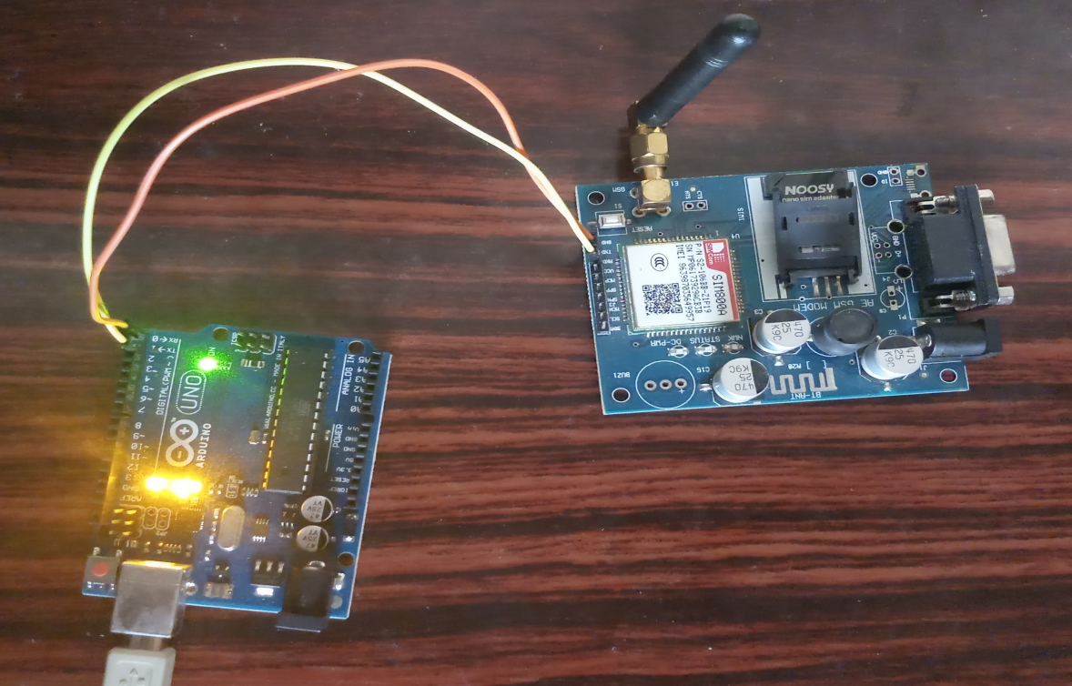
GSM Module

Slide 21
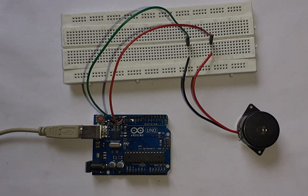
Buzzer

Slide 22
CONCLUSION
This guidance system provides the required and useful information about the distance between vehicle to the present vehicle driver during mist season and to upcoming vehicle driver during every time via the LCD Display which reduces the number of accidents. This proposed model also alerts the driver when the distance between vehicle reduced exponentially or rapidly. Suppose an accident or crash has been occurred our system will gets information about location from an environment and transfer it to the corresponding user via GSM.

Slide 23
FUTURE ENHANCEMENT
In the further enhancement we are planning transfer the data/information to the corresponding user via inbuilt Wi-Fi after implementing more security measures while transferring data via cloud. In addition to that we have planned to observe the changes of speed of the vehicle via GPS which reduce the number of components.

Slide 24
REFERENCES
[1] Charlotte Jacobe-de-Naurois, ChristopheBourdin, AncaStratulat”, “DETECTION AND PREDICTION OF DRIVER DROWSINESS USING ARTIFICIAL NEURAL NETWORK MODELS”, published on May 2019 in Science Direct Journal.
[2] Boddapati Venkata sai Padmaja, Venkata Ratnam Kolluru , Syam Sai Kota, “IOT BASED IMPLEMENTATION OF VEHICLE MONITORING AND TRACKING SYSTEM USING NODE MCU”, published on April 2019 in International Journal of Innovative Technology and Exploring Engineering (IJITEE).
[3] B Devi, S Sai bavatharini, “VEHICULAR SENSING AND AUTOMATIC BRAKING FOR ACCIDENT AVOIDANCE ON THE JUNCTIONS AND BLIND CURVES”, published on July 2018 in International Journal of Pure and Applied Mathematics.
[4] A.Anusha “Vehicle Tracking and Monitoring System to Enhance the Safety and Security Driving Using IoT” 2017 International Conference on Recent Trends in Electrical, Electronics and Computing Technologies (ICRTEECT), July 2017.
[5] Sharmishta Desai, Sourav Roy, Brina Patel, “Very Fast Decision Tree (VFDT) algorithm on Hadoop”, published on August 2016, in IEEE journal.

Slide 25

Thank You!

